Slide 1


UAS Path Planning
Bryce Ford
ford.1009@osu.edu

Slide 2

Talk Overview
Integral constraints
Static vs Path dependent obstacles
Hybrid A*
Planning with vehicle kinematic constraints
Simultaneous planning trajectory generation
Backtracking HA*
Motivation and methodology
Stopping criteria
Performance vs HA*
Other work
Gradient descent path optimization
Flight tests and trajectory following
Virtual Interface

Slide 3
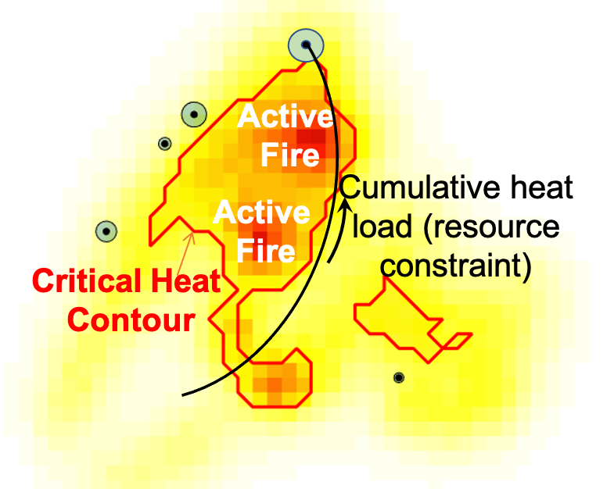
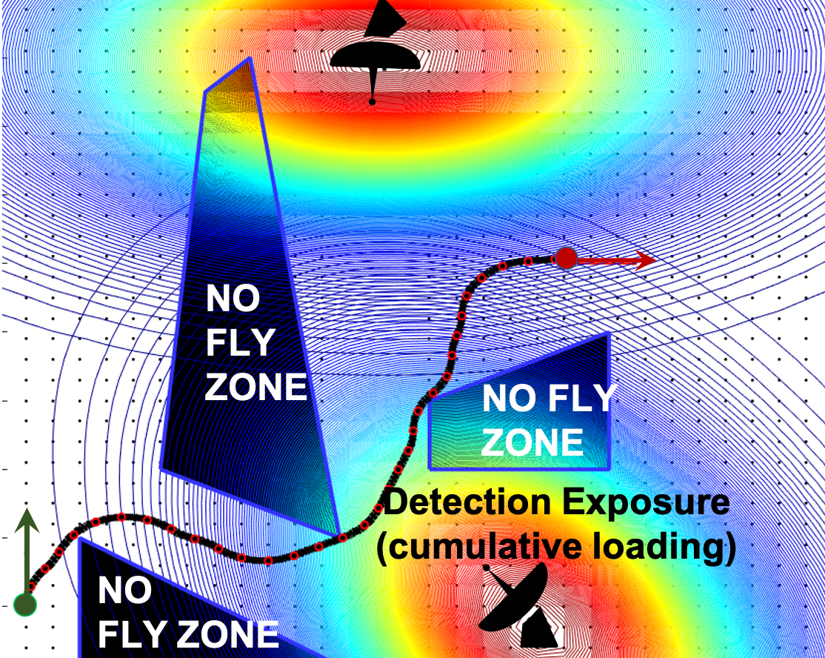
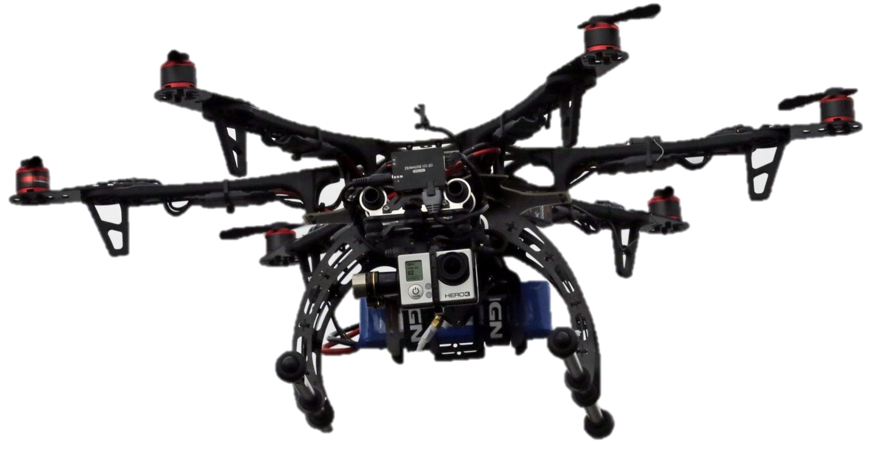
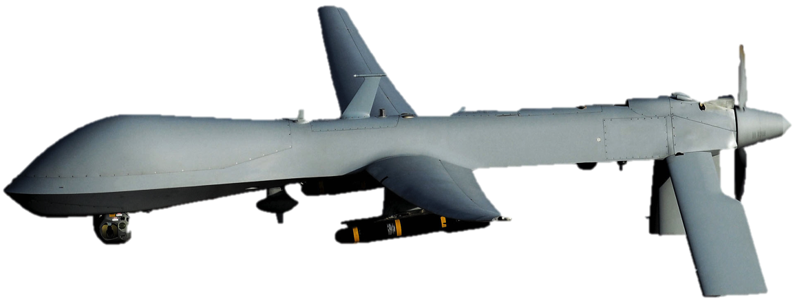
UAS MISSION PLANNING: Intangible Obstacle Scenarios
Scenario 1.
Scenario 2.
Points of Interest
Flight above active fire: UAS safety constraints
Flight through enemy territory: constraint on radar detection, tracking and eventual attack

Slide 4
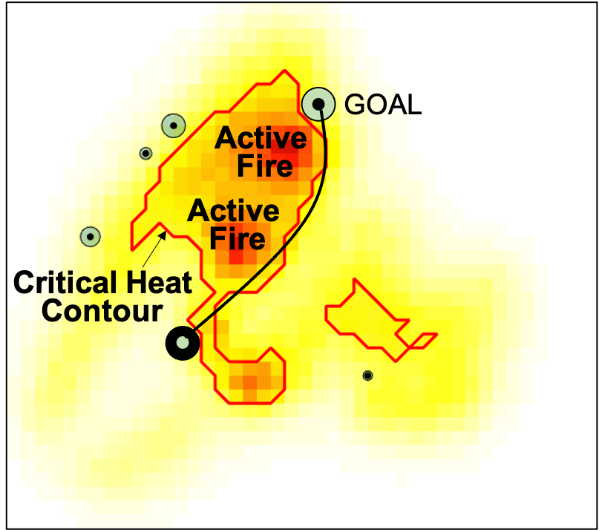
Path Dependent Integral Chance-Constraints
Flight over active wildfire*
Deterministic version of path dependent loading constraint
(7 kW/m²)
where,
(normalized heat-flux)
Integral chance-constraint (path dependent)
*Bryce Ford, Rachit Aggarwal, Mrinal Kumar, S. Gupta Manyam and David Casbeer. Backtracking Hybrid A* for Resource Constrained Path Planning. In GNC @ Scitech Forum, San Diego CA, January 3-7, 2022

Slide 5
Path Dependent Integral Chance-Constraints
Many problems can be posed as a planning problem with accumulating/loading constraints, e.g., cumulative noise, heating, concentration, spending
These are generally studied in the literature as resource constrained optimization problems (mainly in the operational research community)
Resource constrained optimization is known to be NP hard
MILP is the state-of-the-art and can only solve “small scale” problems
We will set up graph search for faster, suboptimal solutions

Slide 6
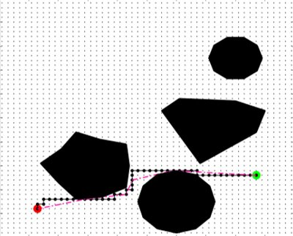
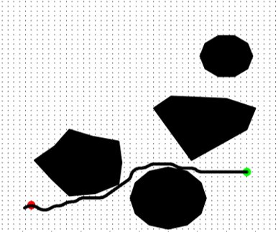
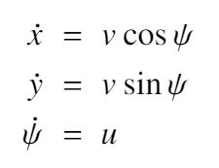


Hybrid-A* Graph Search
Generic A* does not account for vehicle dynamics; (non-holonomic constraints, min turn radius)
Solution for this problem: Hybrid A*
Search over pose space (x, y, θ): Order of magnitude larger than (x, y) state space
Candidate paths are Dubin’s Primitives, and thus will automatically account for vehicles minimum constraints
Will result in a smoother, more flyable path than A*
Vehicle kinematic constraints

Slide 7
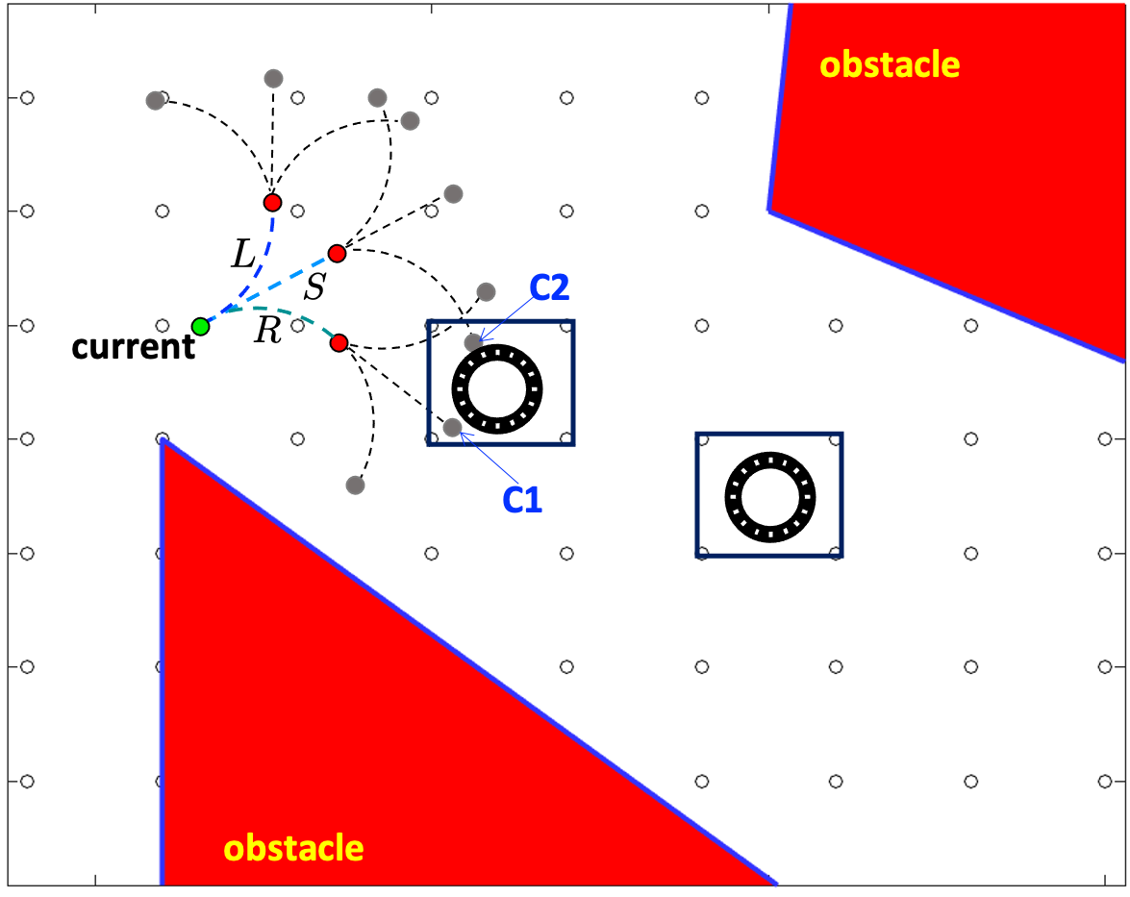
Hybrid-A* Graph Search
How does HA* Work?
3D Grid (x,y,𝜃)
Dubins motion primitives
Graph evolution proceeds as in A*
Obstacles and constraints enforced through node testing
Frontier Evolution

Slide 8
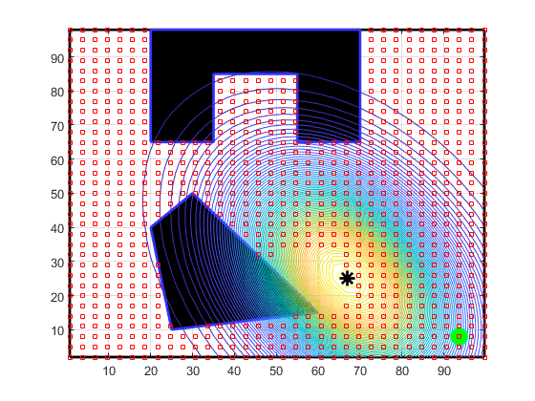
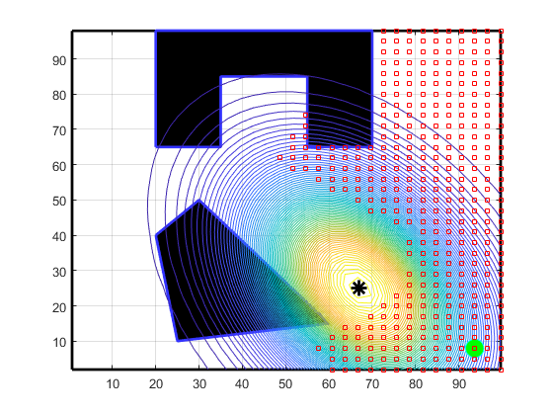
Hybrid-A* Graph Search with Integral Constraints (1/2)
Because path load is a function of the vehicle trajectory
Using A* to generate the path will output a set of waypoints for the vehicle
The actual vehicle trajectory will accumulate a different path-load (likely greater)
This can result in an A* solution that is admissible, but infeasible to the vehicle
No post trajectory optimization is required for Hybrid-A*
Adding a dimension to the search does not increase the runtime by an order of magnitude as the branching factor is still low.
Load minimizing search
Time minimizing search
Integral constraint will behave like an obstacle that is ‘path dependent’
Different search strategies will produce a different obstacle

Slide 9
Hybrid-A* Graph Search with Integral Constraints (2/2)
INADMISSIBLE
NODE
GOAL
POSE
START
POSE

Slide 10
Backtracking Hybrid-A*
The inadmissibility of N* is more the fault of the path taken to reach there, than of “itself”
GOAL
POSE
When an inadmissible node is encountered, we backtrack until a stopping criterion is met
HA* resumes at this point, causing a redirection of the search
START
POSE

Slide 11
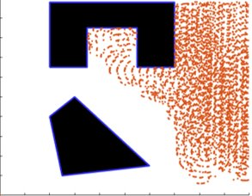
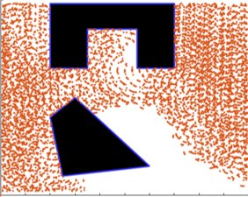
Backtracking Hybrid-A*
Mechanics of Backtracking
To restart the search from the node where the backward march ended, all children of the stop node must be removed from the visited set and frontier.
Released back into the open set.
The result of restarting the search from the stop node is that what would have been the 2nd choice from the frontier is picked and the search continues.
Each backtracking cycle is a step away from the time-optimal path.
The goal is to be able to intelligently take these steps to produce a close to time optimal path that obeys the integral constraint.
This intelligent step is achieved with the stopping criterion.
Backtracking allows for more of the state space to be reached given the loading constraint.
Figures to the right show reachable nodes without any backtracking, and the same search after 70 backtracks.
Reachable without backtracking
Reachable after 70 backtracks

Slide 12
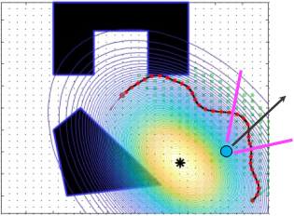
Backtracking Hybrid-A*: Stopping Criteria
Minimum load path stopping:
Stop the backward march when the current load is less than a constant multiple of the minimum possible load.
Requires the minimum load to each node to be computed offline, this is an expensive task as it requires the entire graph to be traversed.
Load to goal stopping:
Stop the backward march when the estimated load to goal plus the current load is less than the limit
Easy to compute, more targeted approach.
Other methods are a topic of current research:
Gradient methods
Random stopping
Predicted load to goal.

Slide 13
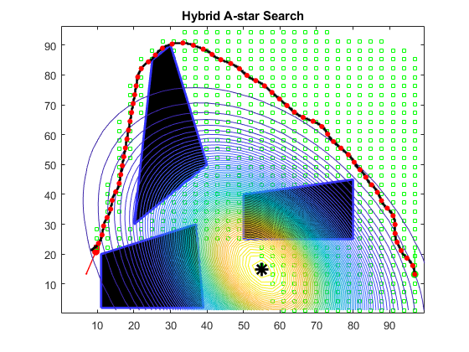
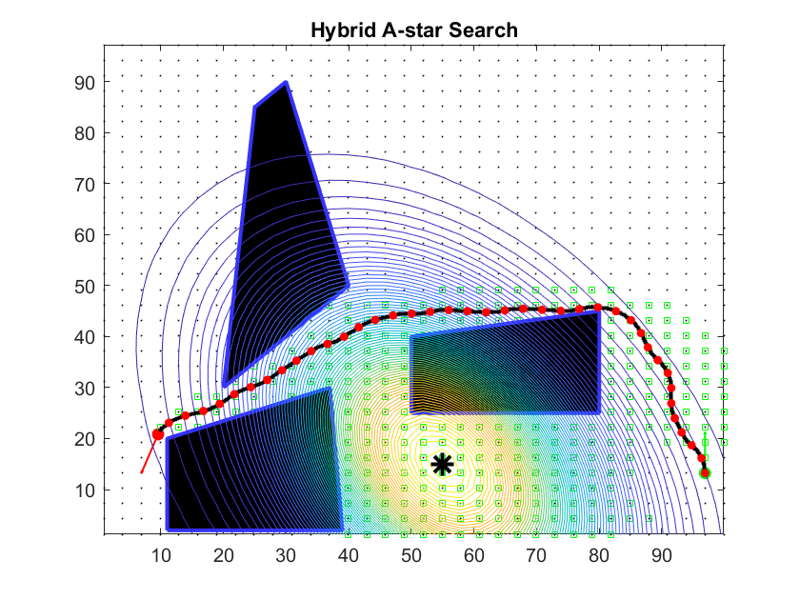
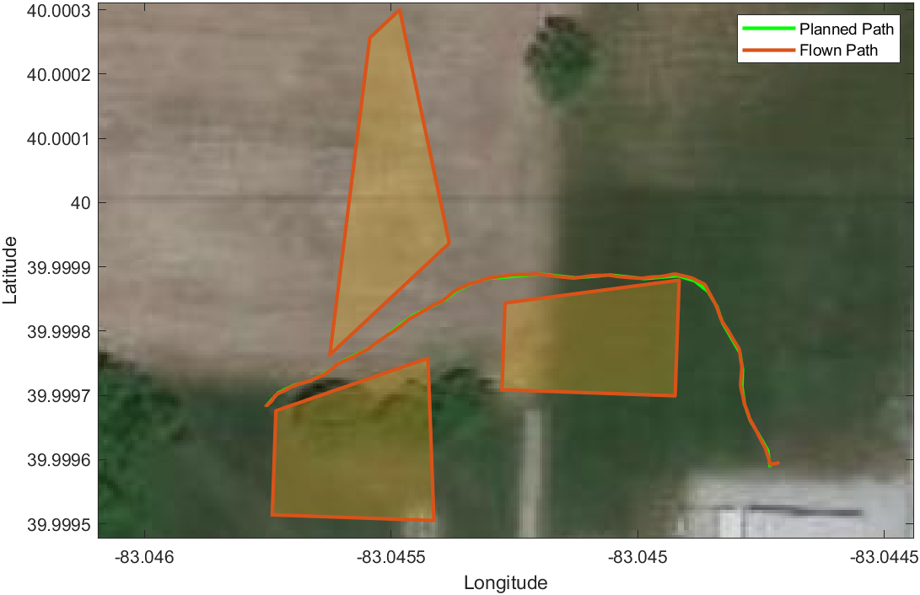
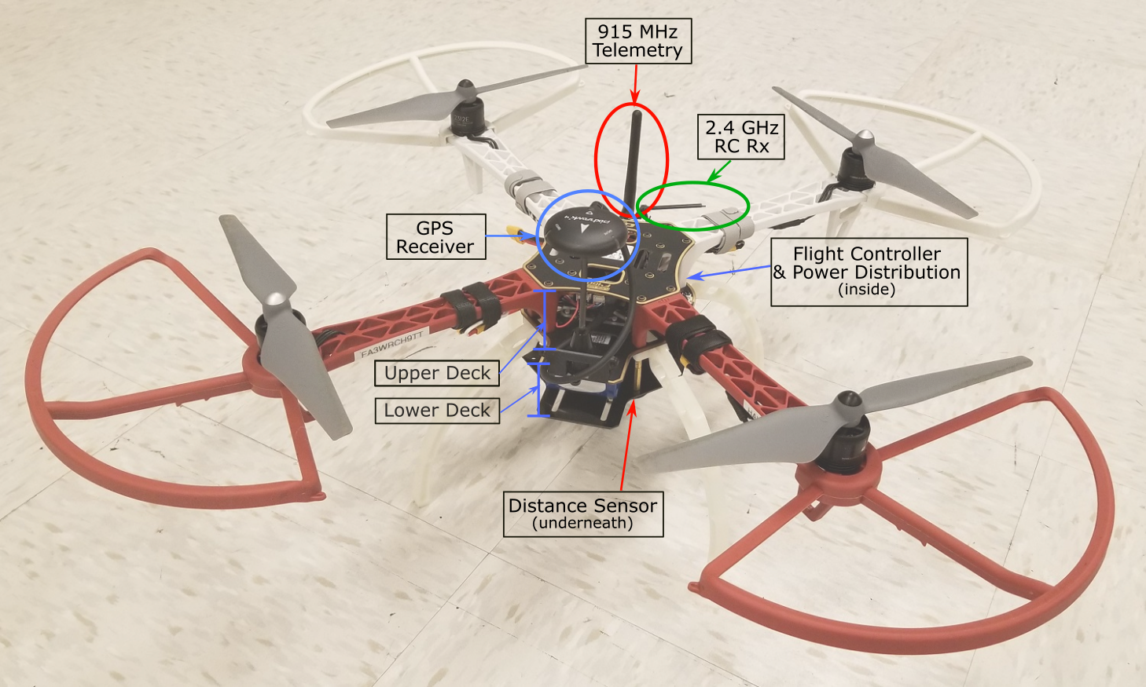
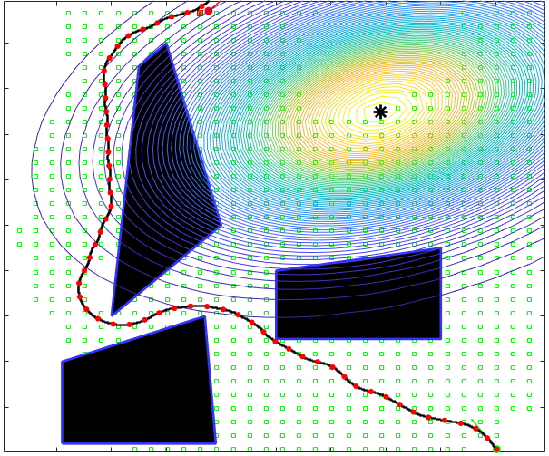
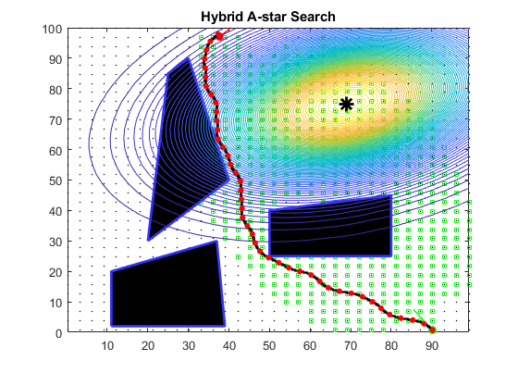
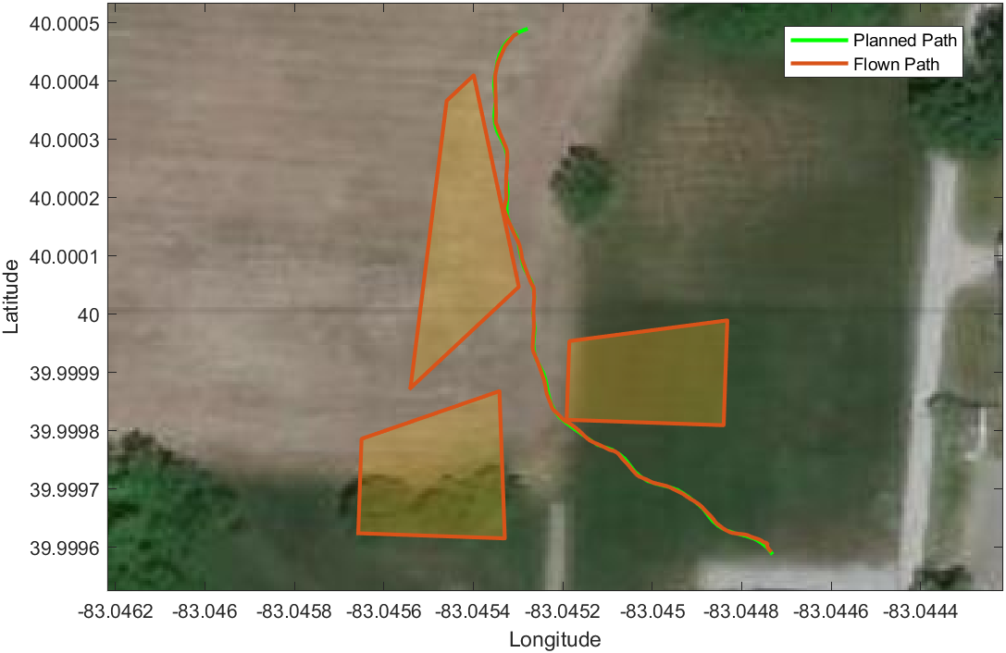
Backtracking Hybrid-A*: Results
A
EXAMPLES*
B
*Bryce Ford, Rachit Aggarwal, Mrinal Kumar, S. Gupta Manyam and David Casbeer. Backtracking Hybrid A* for Resource Constrained Path Planning. In GNC @ Scitech Forum, San Diego CA, January 3-7, 2022

Slide 14
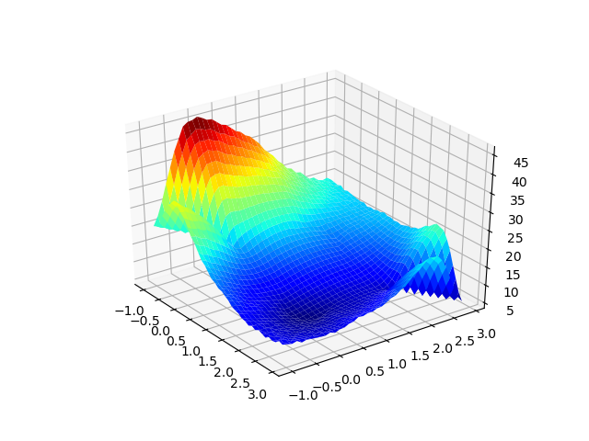
Other Planning Methods
Want to use the gradient of the loading function to aid in optimization but cannot locally interact with it.
Start with the entire path represented as a Bezier Curve.
Use the gradient of the path load with respect to control points defining the curve and perform gradient descent to get a quick solution.
Can create a minimum by adding a penalty for curvature in the objective function.
Could possibly be used as a local planner for in flight avoidance.
Still a very new idea.
Objective function plotted for varying a single control point in (x, y) plane.

Slide 15
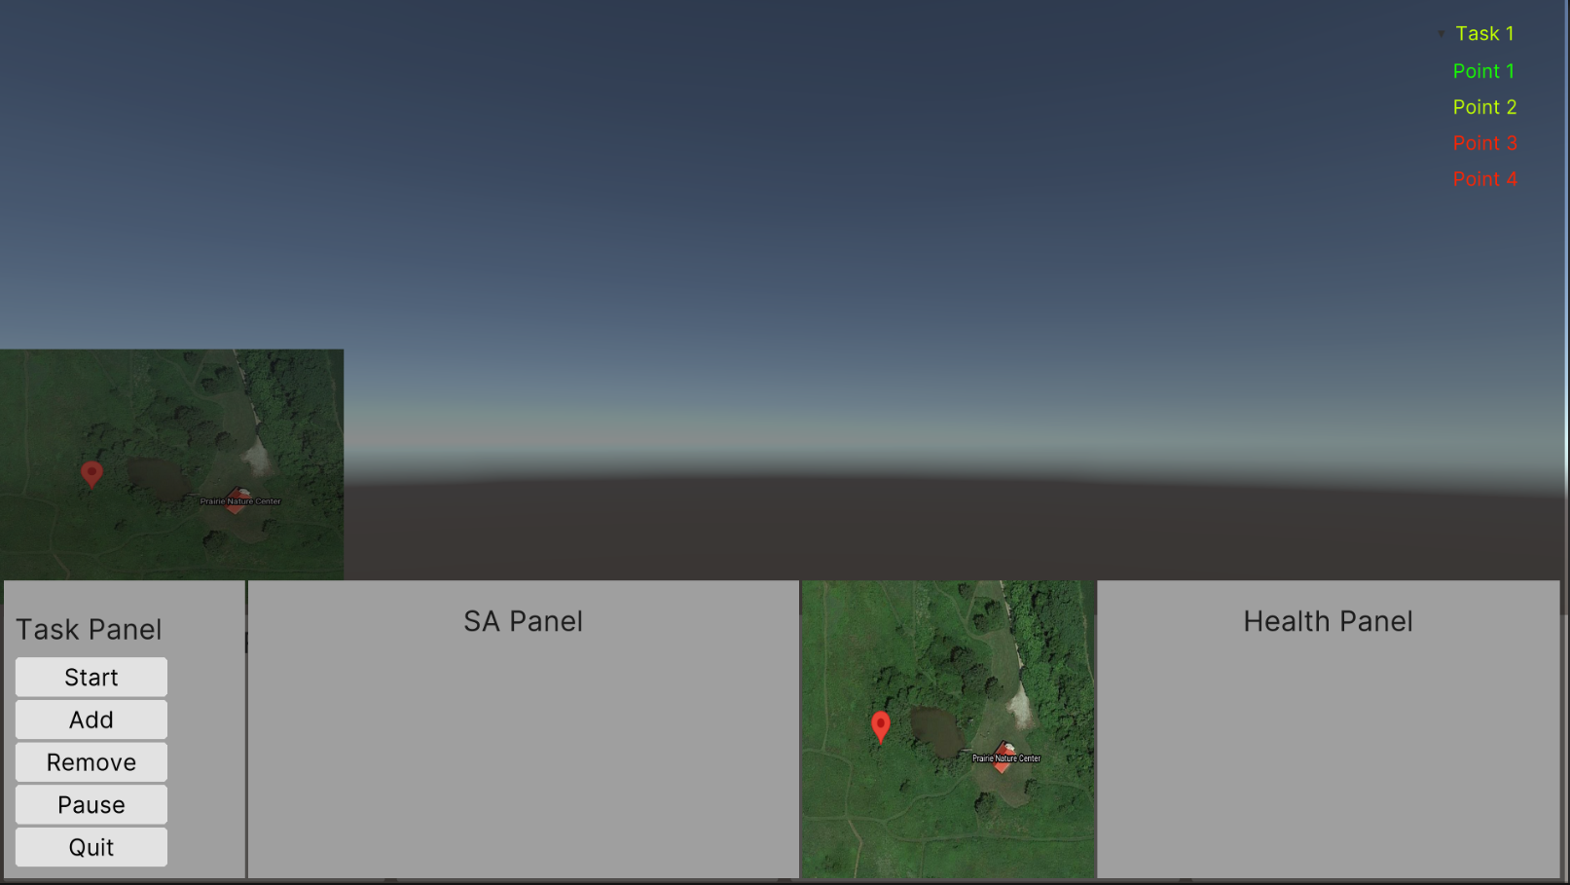
Virtual Interface
Interface for Human and Autonomous Agent teaming
Robust Situational Awareness tool that can be used in a variety of dynamic environments
Credit to Kyle Sharkey

Slide 16

Flight Tests and Controlled Burns
Current work is in getting our Quadrotor to be able to accurately track trajectories.
Our current platform is unable to hit velocity targets for waypoints consistently
Results in a slower average speed and a much higher expected load
Working on ‘hacky’ methods to fix this, but a better long-term solution is needed
Our current goal is to be able to do navigation and trajectory following with a Raspberry Pi as a companion computer.
Future goals include using test flights in controlled burns to put numbers to currently arbitrary loading limits, as well limit testing in fires or under forest canopy.

Slide 17
Questions
Thanks!

